Slide 1
P&T on Balanced Case for Tenure-Track Faculty
Office of Academic Affairs
Willie Miller, Faculty Advancement and Leadership Development Fellow
IUPUI

Slide 2
Balanced – Integrative Workshops
5 Oct. 2023, 10:00 AM
Zoom – Integrative Cases – DEI & Thematic
10 Oct. 2023, 1:00 PM
Zoom – Dossier Preparation Integrative Cases – DEI & Thematic

Slide 3
Rachel Applegate,
Assistant Vice Chancellor for Faculty Affairs
Special thanks to

Slide 4
Agenda
Campus definition of the binned-balanced case
Thinking and talking about balance
Managing balanced cases
Discussion
Panel

Slide 5
Defining Balanced Case

Slide 6
Balanced Case
IUPUI P&T Guidelines
IU Policy: ACA-38 Faculty and Librarian Promotions
“In exceptional cases, a candidate may present evidence of balanced strengths that promise excellent overall performance of comparable benefit to the university.”
IUPUI P&T Guidelines: p. 18
“The candidate must demonstrate that their work constitutes “highly satisfactory” which is clearly more than satisfactory accomplishment in all three areas, with convincing evidence of significant peer-evaluated impact and quality. In the research and teaching areas, highly satisfactory includes peer-reviewed dissemination.”

Slide 7
Levels of Achievement
Satisfactory: internally focused for teaching and service; some dissemination for research
Highly satisfactory: at least some peer-reviewed dissemination
Excellent (for tenure track): emerging (associate) or established (full) national reputation

Slide 8
Levels of Achievement
Satisfactory: internally focused for teaching and service; some dissemination for research
Highly satisfactory: at least some peer-reviewed dissemination
Excellent (for tenure track): emerging (associate) or established (full) national reputation

Slide 9
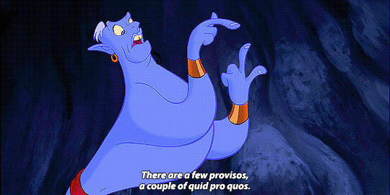
Exceptions
School of Engineering and Technology
School of Science
Library
School of Medicine
© The Walt Disney Company
Notes:
For E&T and Science, Purdue University controls promotions and does not recognize balanced case; they do recognize the Integrative DEI case.
For Librarians, IUPUI P&T standards require excellence in performance for librarians.
For School of Med, the Dean does not allow balanced cases

Slide 10
For tenure-track faculty
Type of case | Dissemination Requirement
Excellence in | Teaching | Research | Service
Teaching | X | X | --
Research | -- | X | --
Service | -- | X | X
Balanced case- binned | X | X | --
Balanced- Integrative | peer-reviewed scholarship required, need not be binned
Binning: for grants, presentations, and publications, each one is designated with one “area” in teaching, research, or service.

Slide 11
The dissemination requirement
”Dissemination” varies by type of activity and by discipline: conference presentations, websites/resources, books, articles.
“Peer-reviewed” means, not just the participants in an activity, or recipients of services, but scholarly/academic peers.
Candidates must have at least some peer-reviewed dissemination in the categories: teaching and research/creative activity.
In service, a candidate may have dissemination that has not gone through a peer-review process.

Slide 12
The point of dissemination is:
If you are doing a good job, share it.
If you have a good idea, share it.
Let others build upon your work.
Appropriate methods of dissemination are very field or context-specific.

Slide 13
Service *new-ish* change
Peer-reviewed dissemination is not required, but candidates must present evidence of the quality and impact of their activities, that demonstrates achievement at a highly satisfactory level.
Accompanied by independent testimony of value of work (university service)
Accompanied by independent evidence of success, impact (service to discipline, community, government)
Played a major role in initiatives over a period of time that contributed to campus/unit/discipline/organizational goals, with independent evidence of significance, role, impact, and effective communication to others.

Slide 14
Document Your Impact
For both traditional and non-traditional forms of dissemination (everything besides journal articles with citation indexes), librarians can help you make it count.
They will show you how to preserve it for future retrieval and boost citations (ScholarWorks)
They will help you document impact (Research Metrics)

Slide 15
Thinking and talking about balance

Slide 16

Strong balanced cases include
Scholarly products in each area
Visibly more than merely satisfactory
A coherent integration across areas
Intentionality
Overall benefit to the University, tied to the unit’s mission

Slide 17
Binning Items: Your Decision
Your Candidate Statement tells the tale of your integrated life as faculty member.
Your CV inventories your work products into different bins (categories)
Life does not equal work products.
One integrated endeavor may have distinct and different work products.

Slide 18
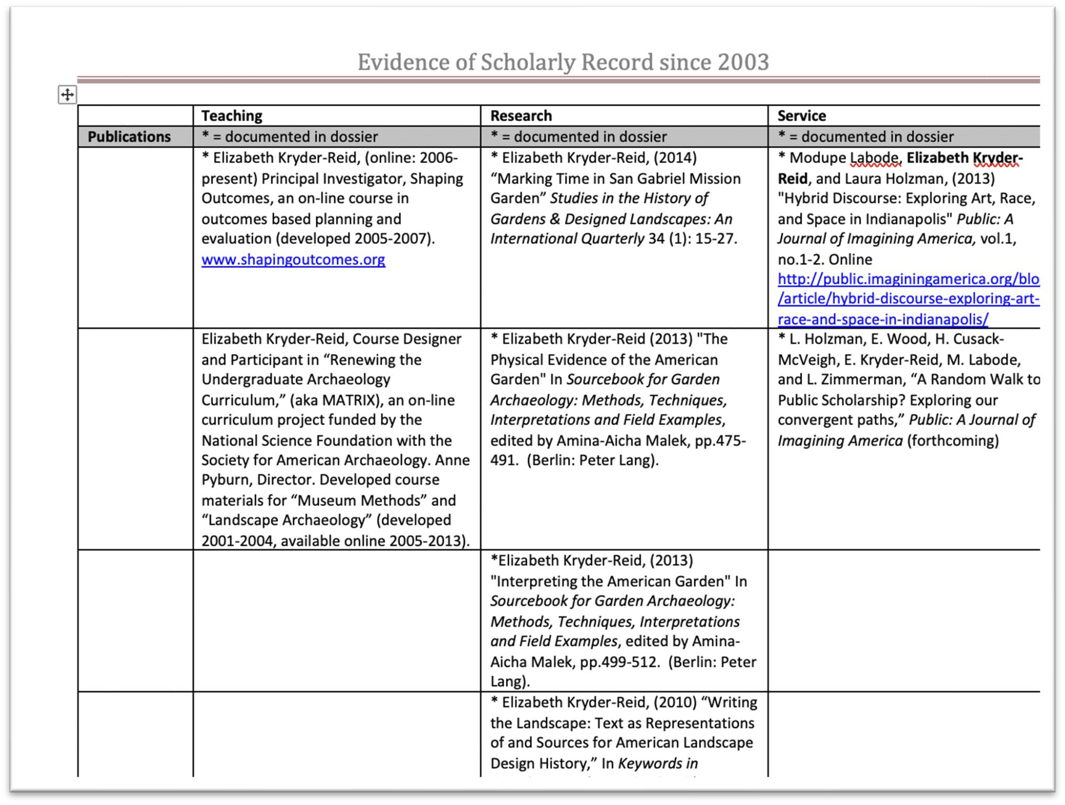
This grid was created by Elizabeth Kryder-Reid to document her balanced case. It shows very clearly how she has addressed each area.

Slide 19
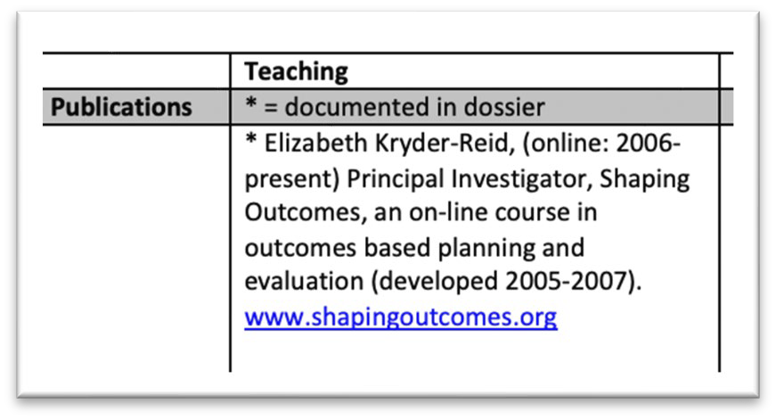
When Rachel Applegate worked on this project (shapingoutcomes.org), she characterized her work as ‘service’ because it was for the benefit of the professional community.
Liz used it primarily for her classes/program = teaching.
Binning is judgmental and individual.

Slide 20
Conceiving a case: Version 1
Who am I?
Explain yourself in 5 minutes to:
Your non-academic parent
Your dissertation chair or academic advisor, meeting at a conference 10 years after graduating
Why do I do what I do?
What did you spend your last summer on? Why?
Where did you publish last? Why? To whom were you talking?

Slide 21
Conceiving a case: Version 2
Look at your CV. Color-code it for potential bins
If going for full, mark in-rank item
Note all student co-authors
Mark multiple potential bins
Is it consistent with who you are and how you spend your time?
"I do this, because that, which advances my program/unit
Where are there gaps?
Next steps in strengthening your CV and/or your statement/case

Slide 22
Managing balanced cases
Balanced cases are unusual and unique. OAA and your school are happy to give you individual advice.

Slide 23
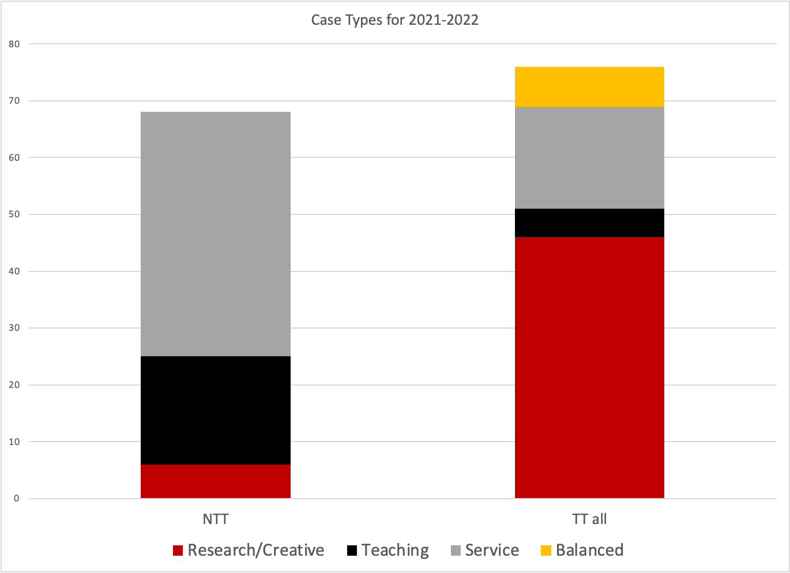

Slide 24
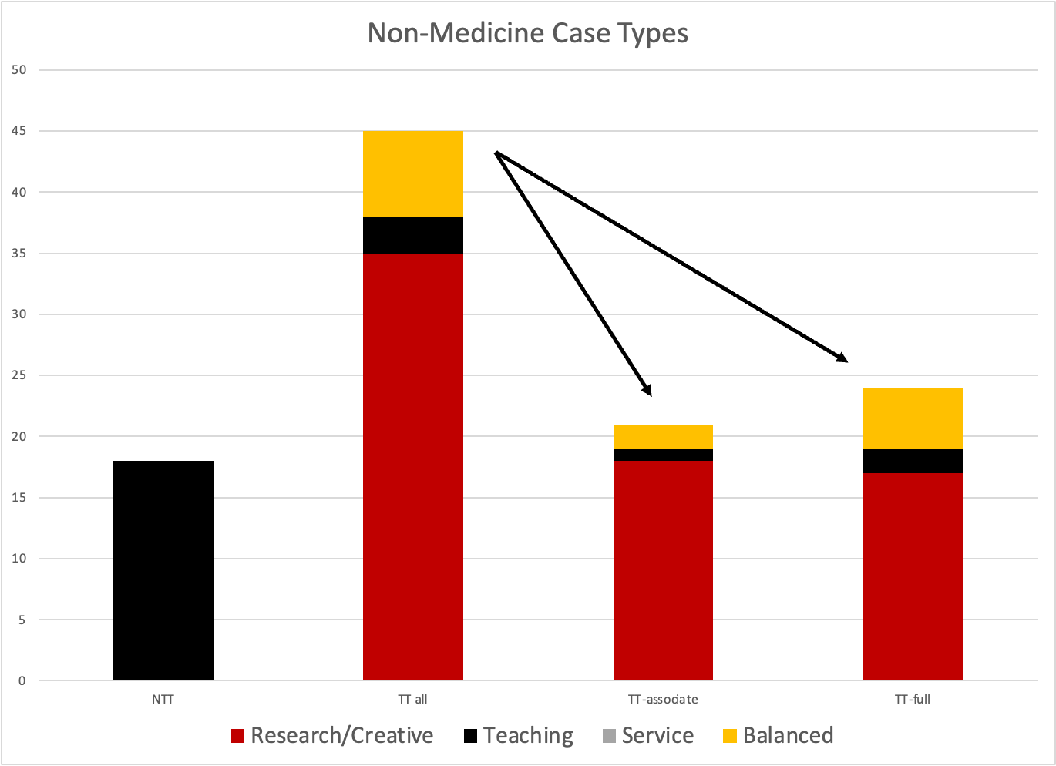
Notes:
2 TT-Associate, 5 TT-Full

Slide 25
An Unusual Case
Balanced case is not discouraged by the campus
Balanced cases are treated carefully – as all are – by the campus committee
A balanced case is not automatically an “all-read” (problem) case
Most of your readers have most of their experience with research cases.
You must educate, explain, and enthuse.

Slide 26
External reviewers and other people to provide input
External reviewers must be:
Academics. One or two might be non-academics, but the chair needs to make a strong specific case for their expertise in evaluating scholarly value.
At the desired or higher rank; at a comparable or higher institution
Not co-authors, co-PIs, or mentors
Able to review and evaluate the candidate’s work; they do not need to be experts in all aspects.
Margie Ferguson and Rachel Applegate can help chairs brainstorm reviewers

Slide 27
External reviewers and other people to provide input
Chairs can solicit other letters:
These letters go into a special non-candidate folder. They are more valuable than candidate-solicited letters, but less than external reviewers.
Especially valuable for service (and sometimes teaching) where there are limited formal publication products
Clients and partners in projects can provide their perspectives
Especially appropriate for experts who are not academics

Slide 28
Do you do community engaged work?
There is a special, voluntary additional review committee, initially for third year reviews, eventually for tenure reviews.
This committee writes an additional evaluation that will place the candidate’s work in the context of community-engaged scholarship
Upcoming Workshop: P&T for Community/Publicly Engaged Work on October 2nd at 1pm.

Slide 29
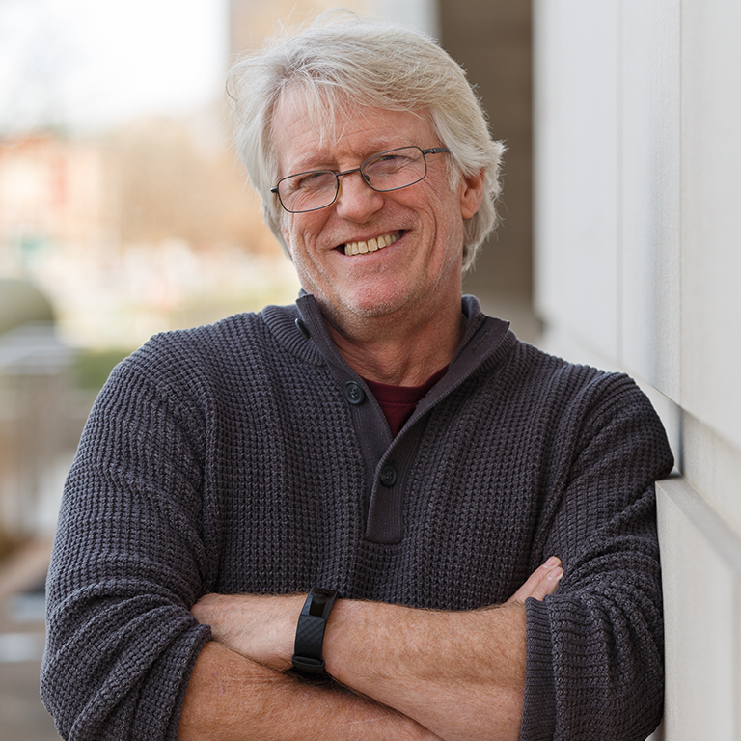
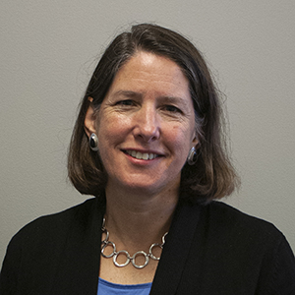
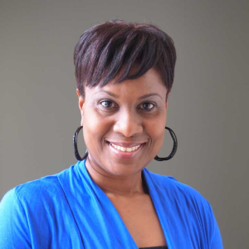
Super useful:
Sample Dossiers on OAA Website
Greg Hull, Herron School of Art and Design (now dean). Dossier
Elizabeth Kryder-Reid, School of Liberal Arts. Evidence Grid
Jennifer Thorington-Springer, School of Liberal Arts. Dossier (strongly connected to DEI Integrative Case)

Slide 30
New! CV Formatter
Requires 3 things:
The Courses report from DMAI
Listing of grants from DMAI or GMT
Regular, up-to-date disciplinary CV

Slide 31
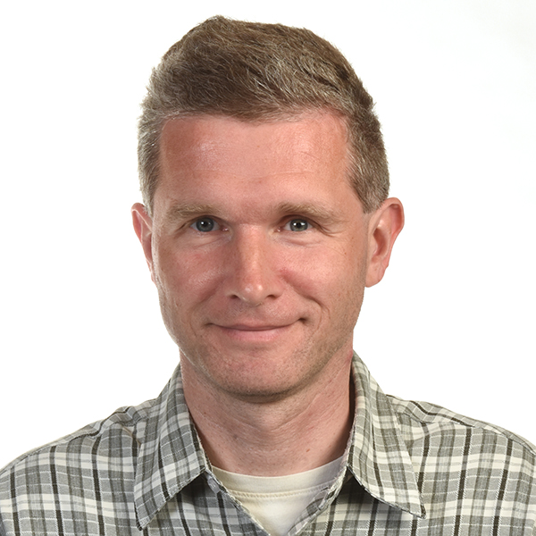
Discussion and Panel
Frank Lippert
Professor
School of Dentistry

Slide 32
Willie Miller
Faculty Advancement and Leadership Development Fellow
wmmiller@iupui.edu
Rachel Applegate
Assistant Vice Chancellor for Faculty Affairs
rapplega@iupui.edu
Margie Ferguson
Senior Associate Vice Chancellor for Academic Affairs
mferguso@iupui.edu

